Slide 1
School of Geography and Geology
McMaster University
Advanced Topics in Spatial Statistics
Session 12
Spatially Continuous Data III

Slide 2
This session
Generalized least squares
Spatial prediction
Simple kriging

Slide 3
Generalized Least Squares (GSL)
OLS
  Variance is constant
  Error terms are independent (i.e. random)

Slide 4
Generalized Least Squares
More general regression model
  Relaxes some of the assumptions imposed on the error terms
  Non-constant variance
  Spatial dependency (spatial structure)
Incorporate residual spatial structure

Slide 5
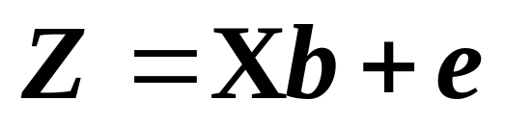
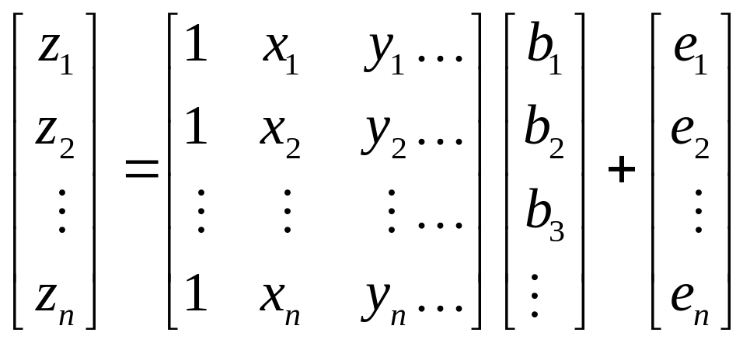
Regression Analysis
Matrix notation

Slide 6
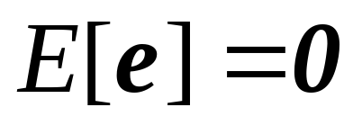
Regression Analysis
Error terms (OLS and GLS)
  Expected (mean) value = 0

Slide 7
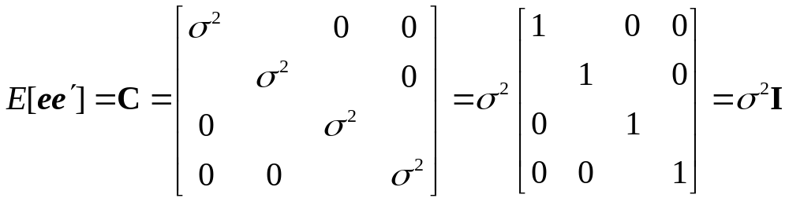
Regression Analysis
Error terms (Ordinary Least Squares)
  Constant variance
  Independent

Slide 8
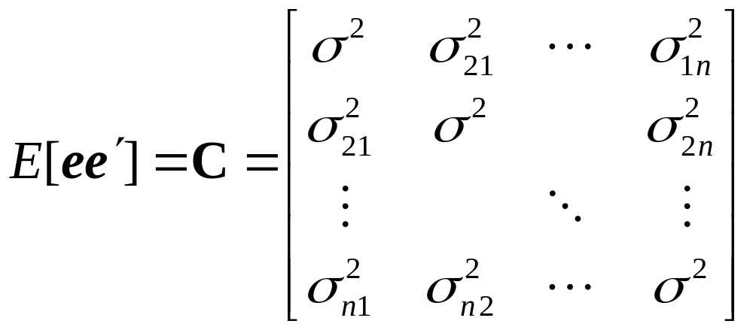
Regression Analysis
Error terms (Generalized Least Squares)
  Constant variance
  NOT Independent: covariance between e_{i} and e_{j} ≠ 0

Slide 9
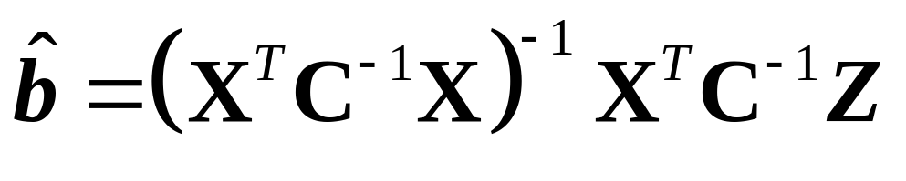
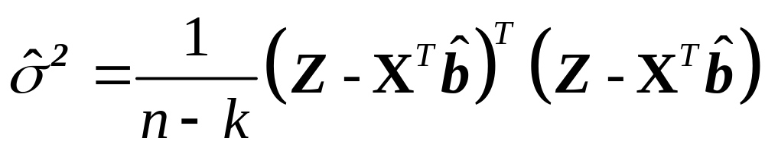
Regression Analysis: GSL
Parameters
Variance

Slide 10
Spatial Prediction
Q: What are the implications of spatial structure for prediction?

Slide 11
Spatial Prediction
Error terms are not completely random, i.e., unpredictable
s₆
s₁
s_{p}
s₅
s₂
s₄
s₃

Slide 12
Spatial Prediction
Kriging
  So called after South African mining geologist D.G. Krige
  Method for spatial prediction
  Makes use of autocorrelation information
  Optimal spatial prediction!

Slide 13
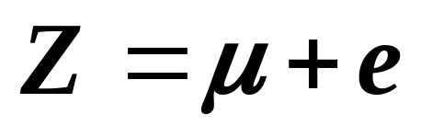
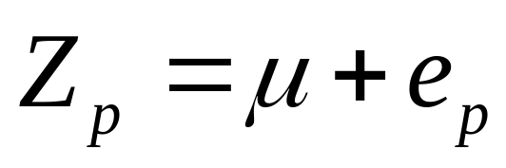
Simple Kriging
A method for optimal prediction when there is no trend (first order effects), or when the trend is known
Model with constant or known trend μ
Spatial prediction

Slide 14
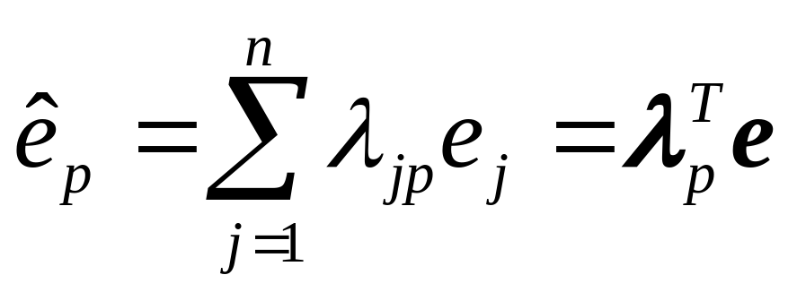
Simple Kriging
When errors are autocorrelated
s₆
s₁
s_{p}
λ_{jp}: linear weights
s₅
s₂
s₄
s₃

Slide 15
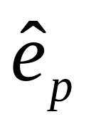
Simple Kriging
is a random variable
  Expected (mean) value = 0
  How close (on average) is it to e?

Slide 16
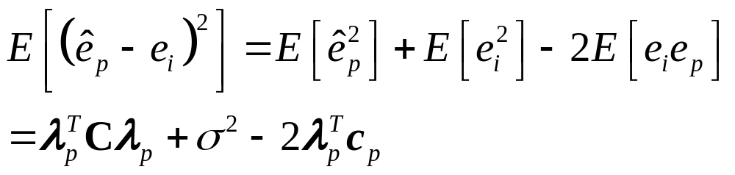
Simple Kriging
How close (on average) is to e?
  Expected mean square error (prediction variance):
C: covariance matrix
c_{p}: covariance vector between e and

Slide 17
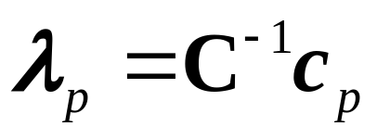
Simple Kriging
Minimizing the expected mean square error gives weight λ:
C: covariance matrix
c_{p}: covariance vector between e and

Slide 18
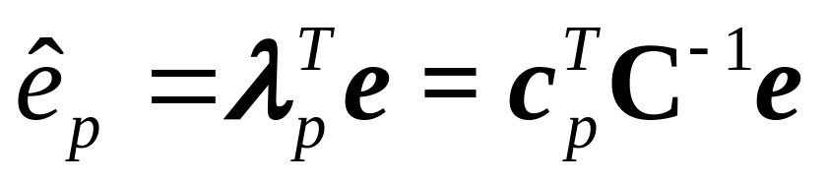
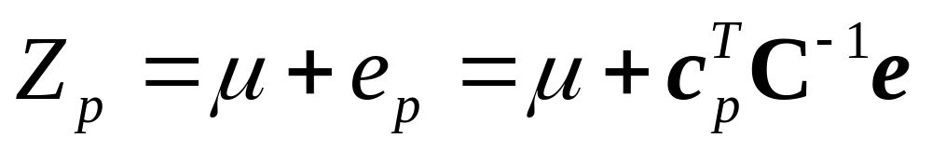
Simple Kriging
This leads to:
Which can be added to the known mean to give:

Slide 19
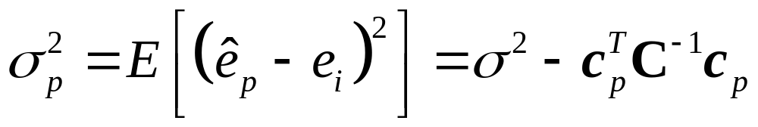
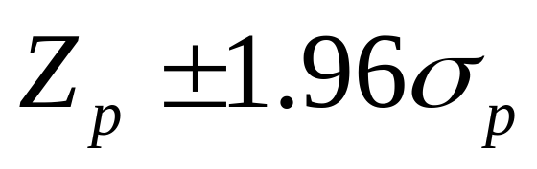
Simple Kriging
Prediction variance:
Interval of confidence for prediction (95% level of confidence):

Slide 20
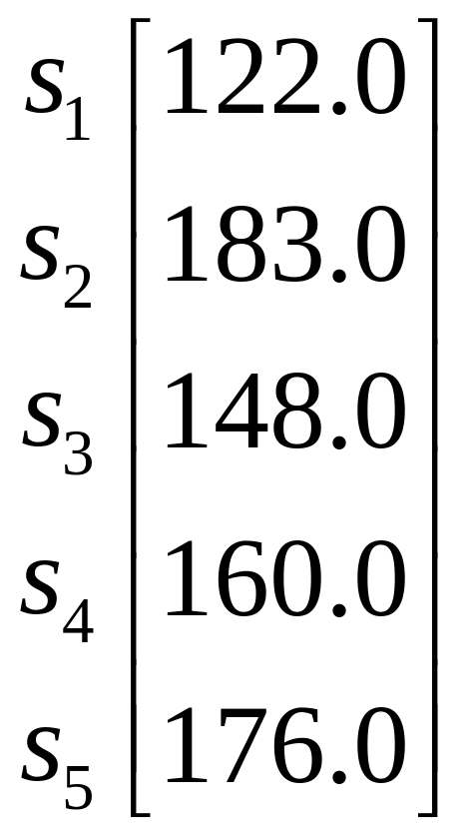
Simple Kriging in Action
Site
Z
s₂
s₁
s_{p}
s₃
s₄
s₅

Slide 21
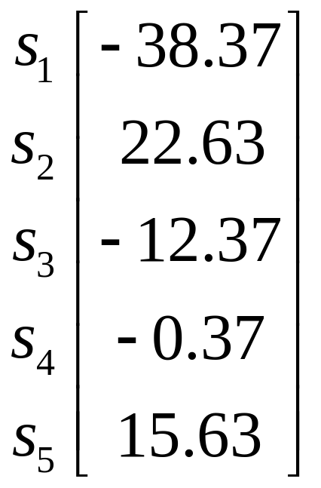
Simple Kriging in Action
Known constant mean μ=160.37
Error terms:
e

Slide 22
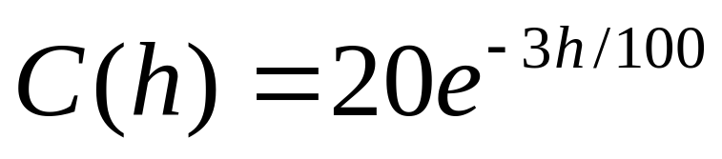
Simple Kriging in Action
Covariance structure given by an exponential variogram:
Sill: 20
Range:100

Slide 23
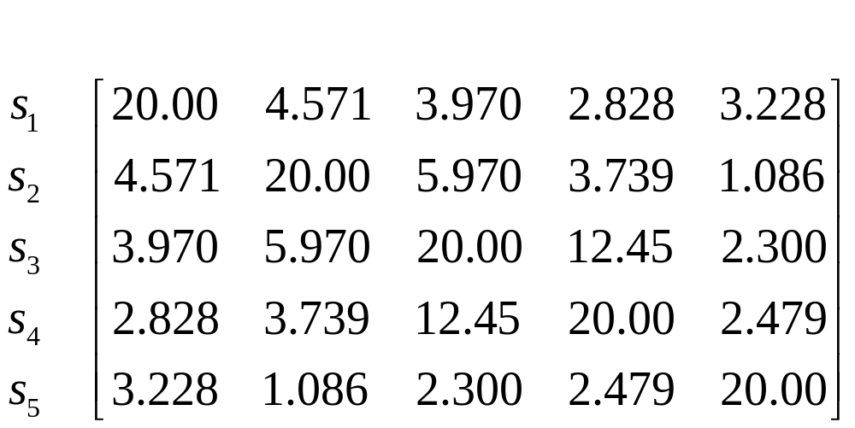
Simple Kriging in Action
Covariance matrix:

Slide 24
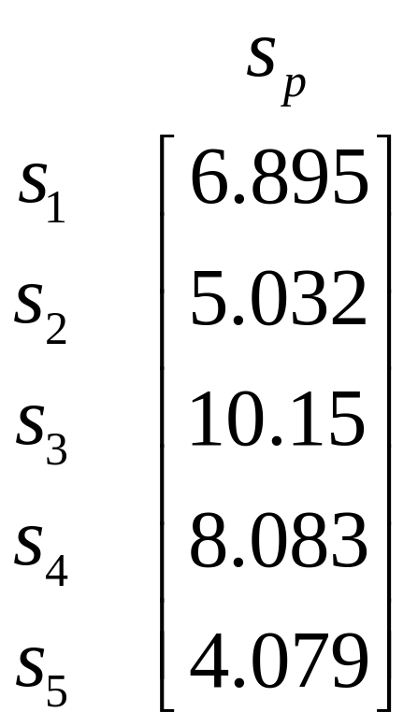
Simple Kriging in Action
Covariance vector between location s_{p} and locations s_{i}:

Slide 25
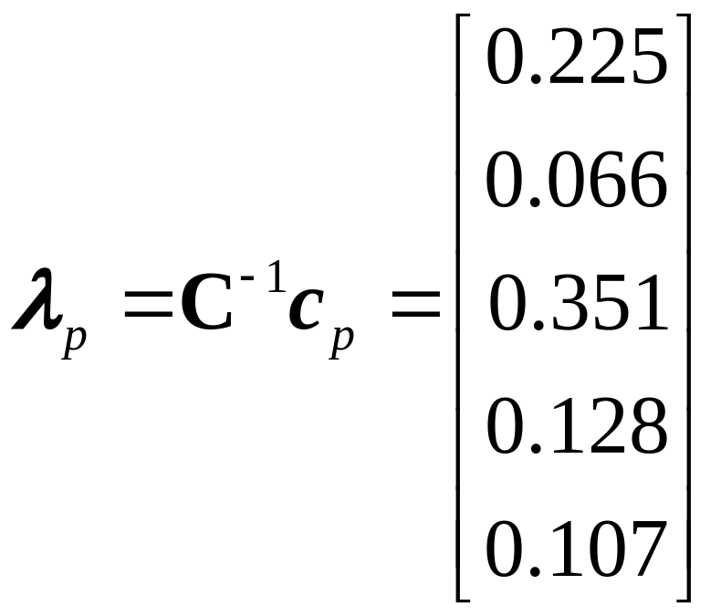
Simple Kriging in Action
Kriging weights:

Slide 26
Simple Kriging in Action
s₂
0.066
s₁
s_{p}
0.351
0.225
s₃
0.128
s₄
0.107
s₅

Slide 27
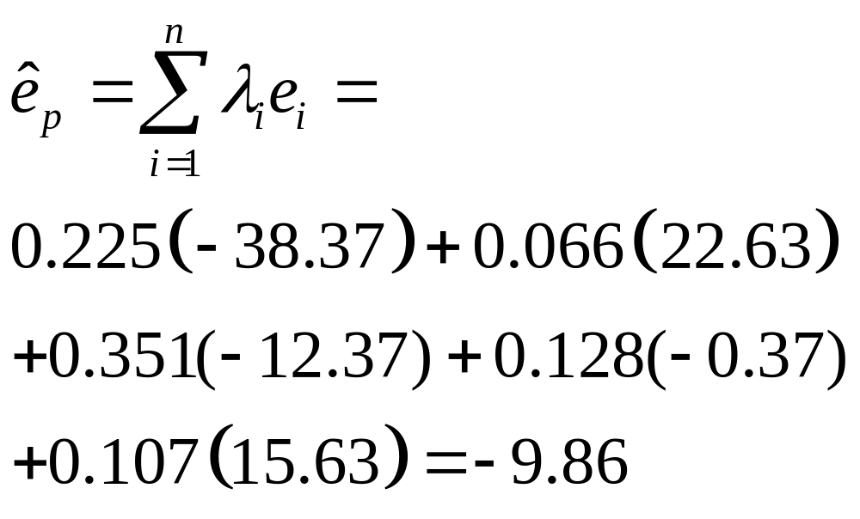
Simple Kriging in Action
Spatial prediction

Slide 28
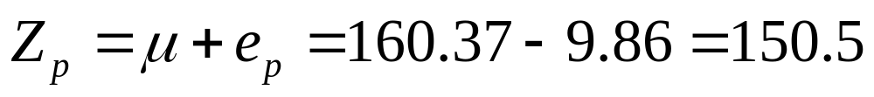
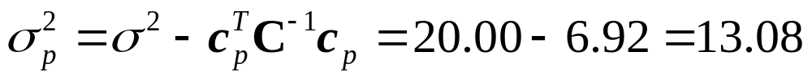
Simple Kriging in Action
Spatial prediction
Prediction variance

Slide 29
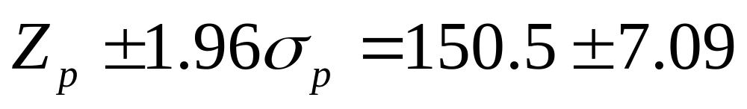
Simple Kriging in Action
Interval of confidence

Slide 30
Simple Kriging
Limitations
  Trend is not always constant or known
  Covariance structure is not known

Slide 31
Next…
Spatially continuous data IIII
  Variogram selection
  General spatial prediction
  Ordinary and universal kriging
  Examples

